Slide 1
COVID-19 CASES IN WEST UTTAR PRADESH
CONFIRMED CASES DURING MONSOON AND POST MONSOON
Name- Nishant Kumar Upadhyay
Course- Regulatory Policy and Governance
E.ID- M2020RG015

Slide 2
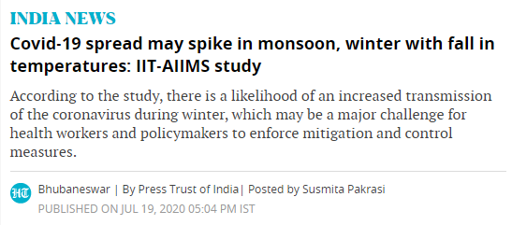
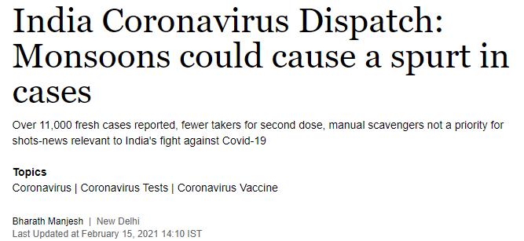
Objective
As Covid-19 cases surged in India in the end of March month, here the objective of the project is to analyse the covid spread in monsoon and post monsoon season.
To understand the impact of weather condition of monsoon on covid surge or spread.
These News Clips that hypothesis the covid may spike in monsoon. In this project we do Ex-Post analysis to know the real condition of covid during and post monsoon.

Slide 3
Data
Data used to analyse the covid case on time scale of during monsoon and post monsoon is taken from Covid India Organization. Link of data: https://www.covid19india.org/
Nature of data is linear on time scale, data is vast in nature as it covered every day cases at nation level so extraction of data for particular area of study has been done in this project.
My area of study is west Uttar Pradesh, which comparises 25 Districts: Meerut, Bulandshahr, Gautam Buddha Nagar, Ghaziabad, Baghpat, Saharanpur, Muzaffarnagar, Moradabad, Bijnor, Rampur, Amroha, Bareilly, Badaun, Pilibhit, Shahjahanpur, Agra, Firozabad, Mainpuri, Mathura, Aligarh, Etah, Hathras, Etawah, Auraiya and Farrukhabad.
Data used in the map is total average of 3 months Confirmed cases of Covid-19 During Monsoon months (e.g. July, August, September.) and Post Monsoon months (e.g. October, November, December).

Slide 4
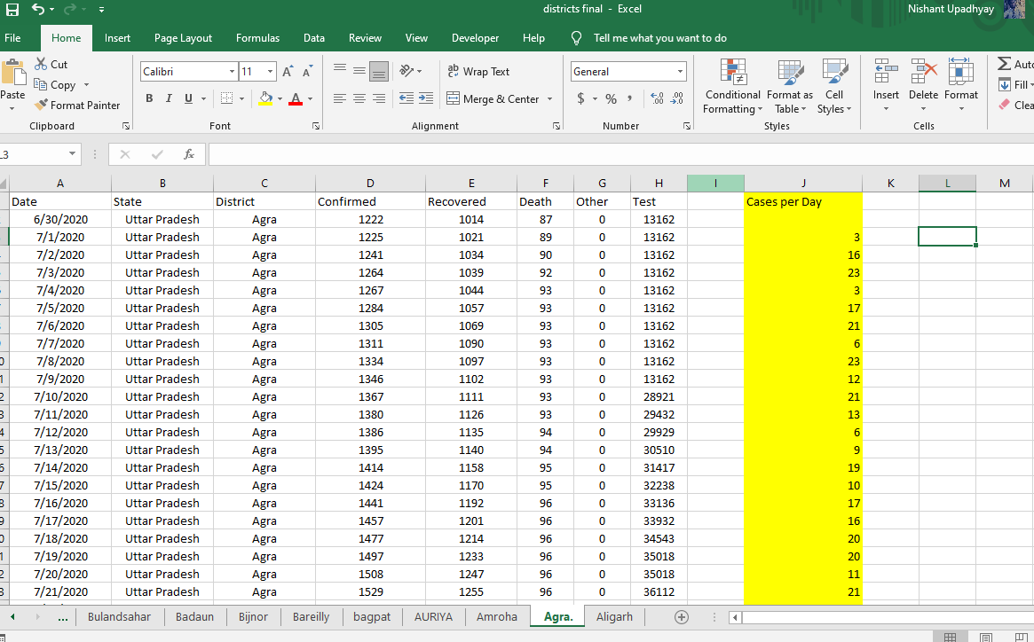
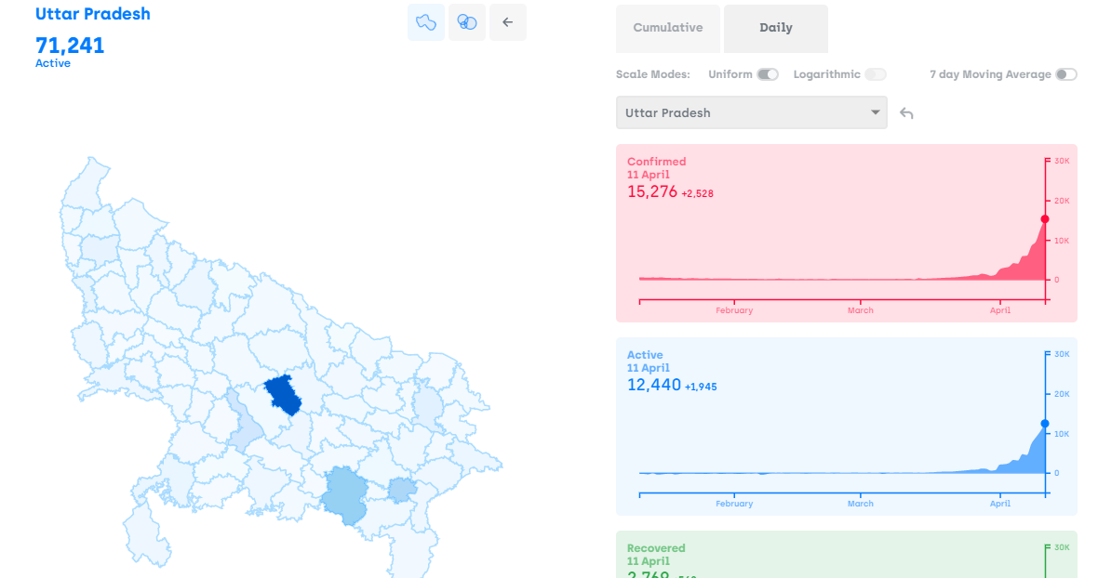
Method
Spatial and geographical Tracking of data in near real time data updates from Covid India Org. Github platform.
Used Q-GIS as a tool to draw the map of covid cases on the basis of data extraction and method of spatial tracking of near real time data given by covid india organization.
Excel used to extract the data from large body of data as area of interest, (Data extraction from excel through data analysis method).
Excel data extraction
covid india organization

Slide 5
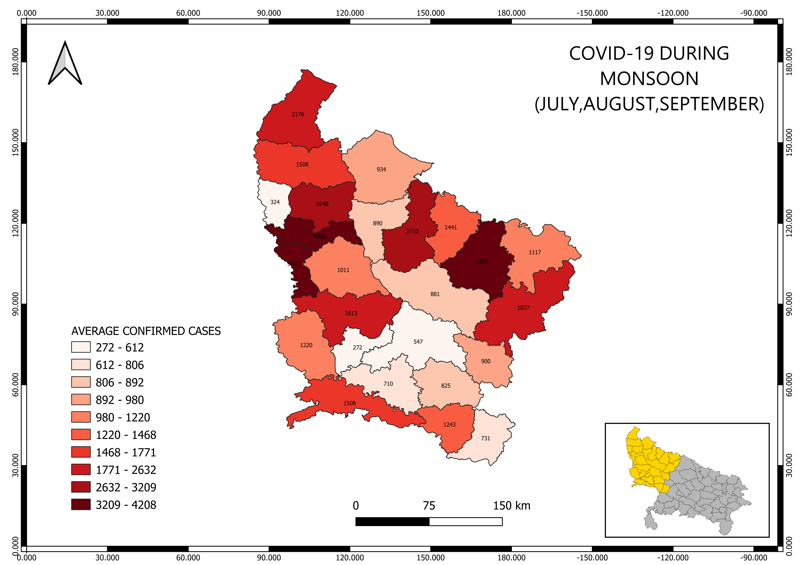
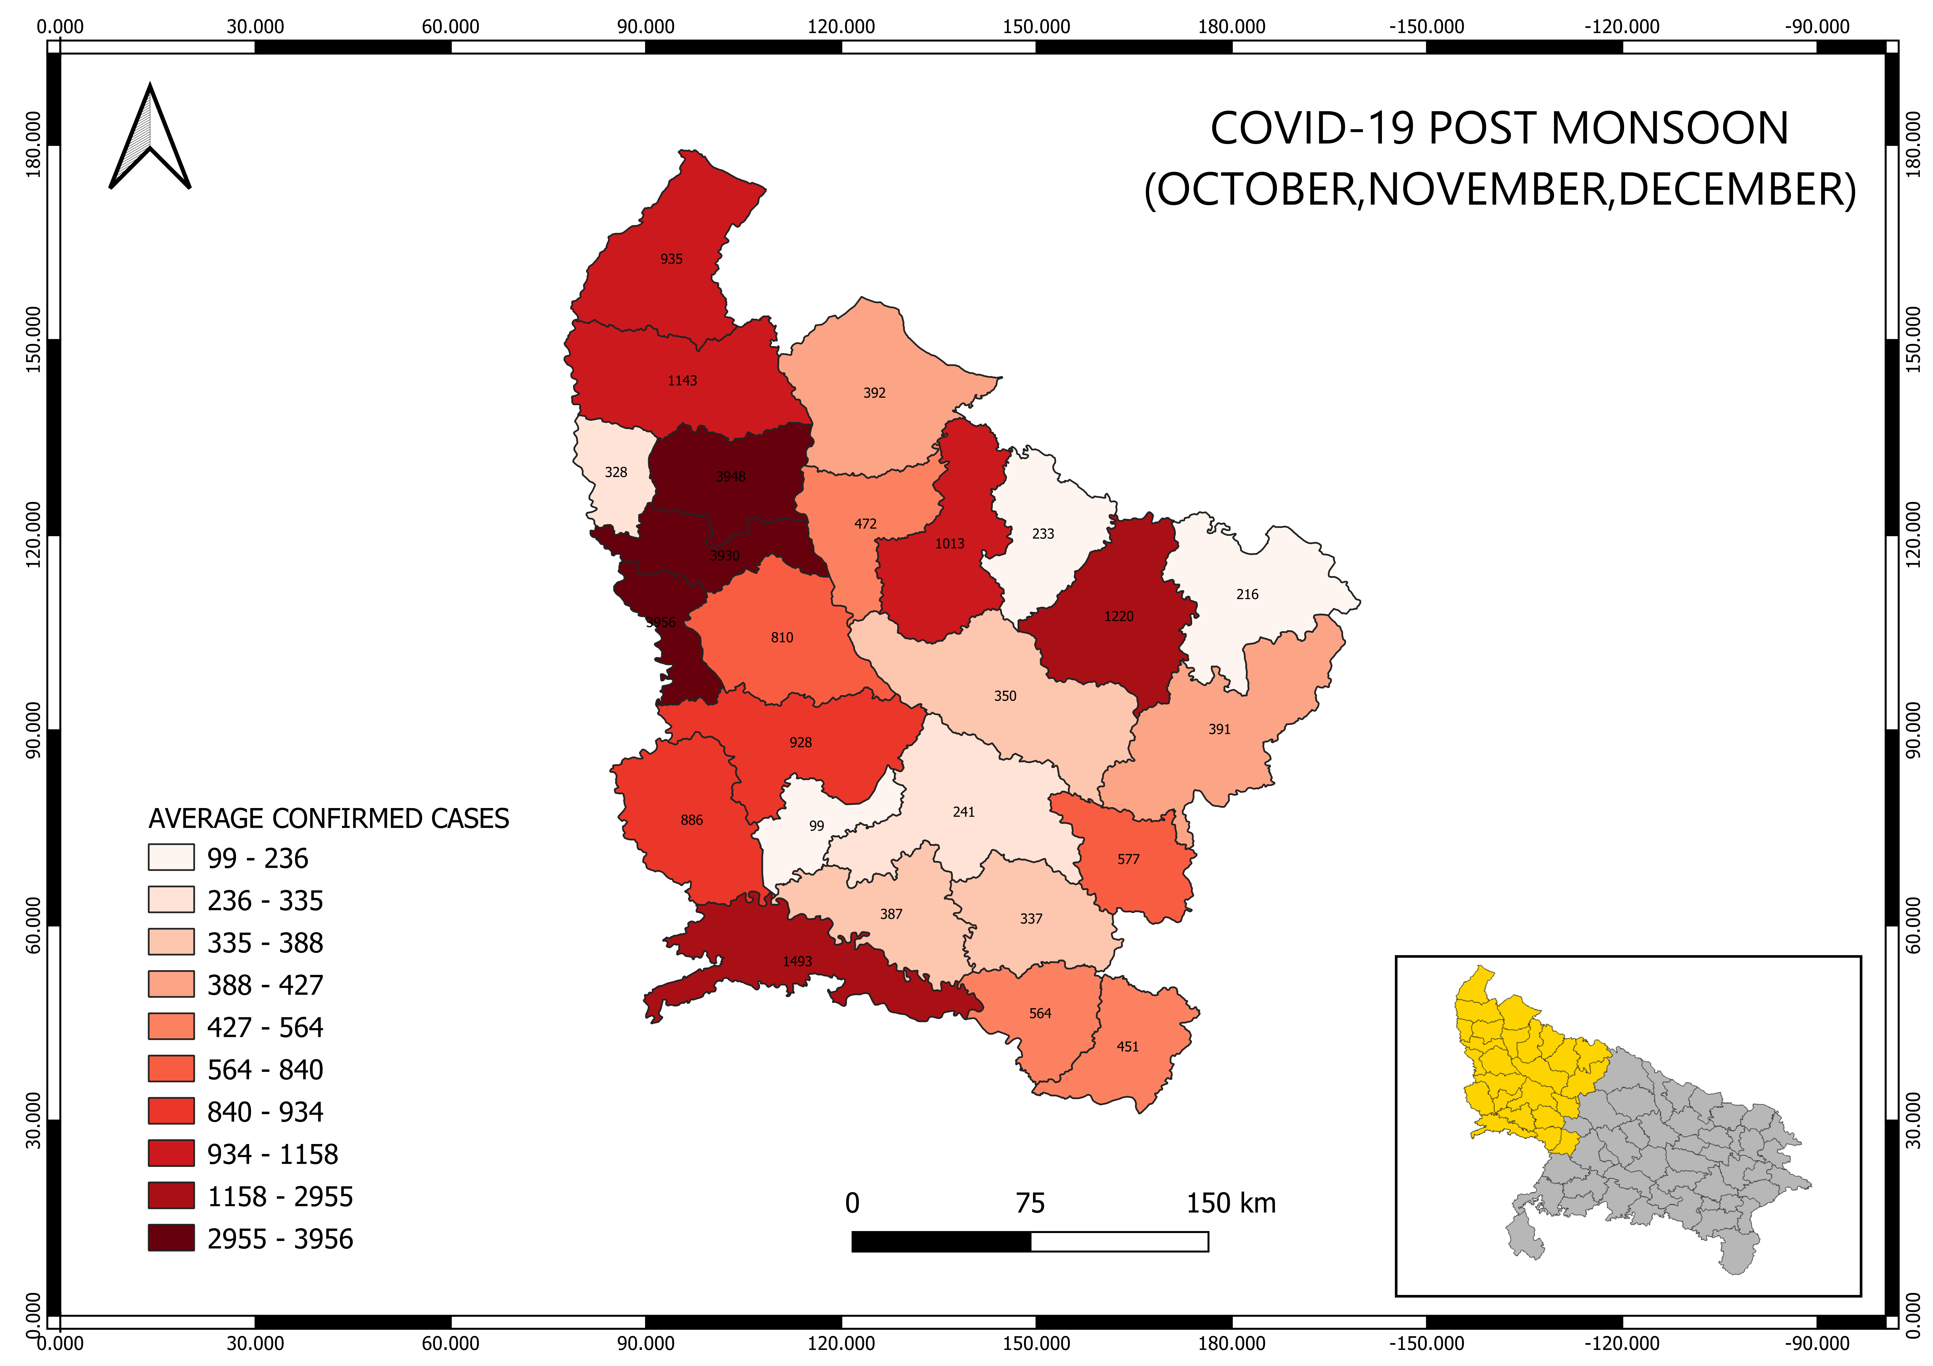
Results
As we can see the map of covid situation during monsoon and post monsoon.
During monsoon Result
Post Monsoon Result

Slide 6
Observation & Conclusion
As we can see Darker gradient has more value and lighter one is less.
On comparing the maps during and post monsoon the districts which has more covid-19 confirmed cases has more recovery rate as well as more death rate also.
On comparing During and Post monsoon, the rate of cases during monsoon is little more in comparison to post monsoon.
The large districts with more population density has very high rate of cases which shows the community spreading of corona virus. (e.g. Gaziabad, Gautam Budha Nagar, Bareilly).
The districts which are near to Delhi or large urban districts has high number of cases with high rate.(e.g. Gaziabad, Gautam Budha Nagar).
More confirmed cases in during monsoon districts has continuously has high confirmed cases in post monsoon also in comparison to less ones, but the number of cases declined in post monsoon in each districts, while during monsoon cases are comparatively high in each districts.

